Slide 1




DESIGNING PERSISTENT PATHS TO SUSTAIN Wireless Sensor Networks Srikanth K. V. Sudarshan and Aaron T. Becker Electrical and Computer Engineering University of Houston Email: srikanth.kvs11@gmail.com, atbecker@uh.edu
2015 Texas Symposium on Wireless and Microwave Circuits and Systems Session D: Communication and Sensing Systems

Slide 2
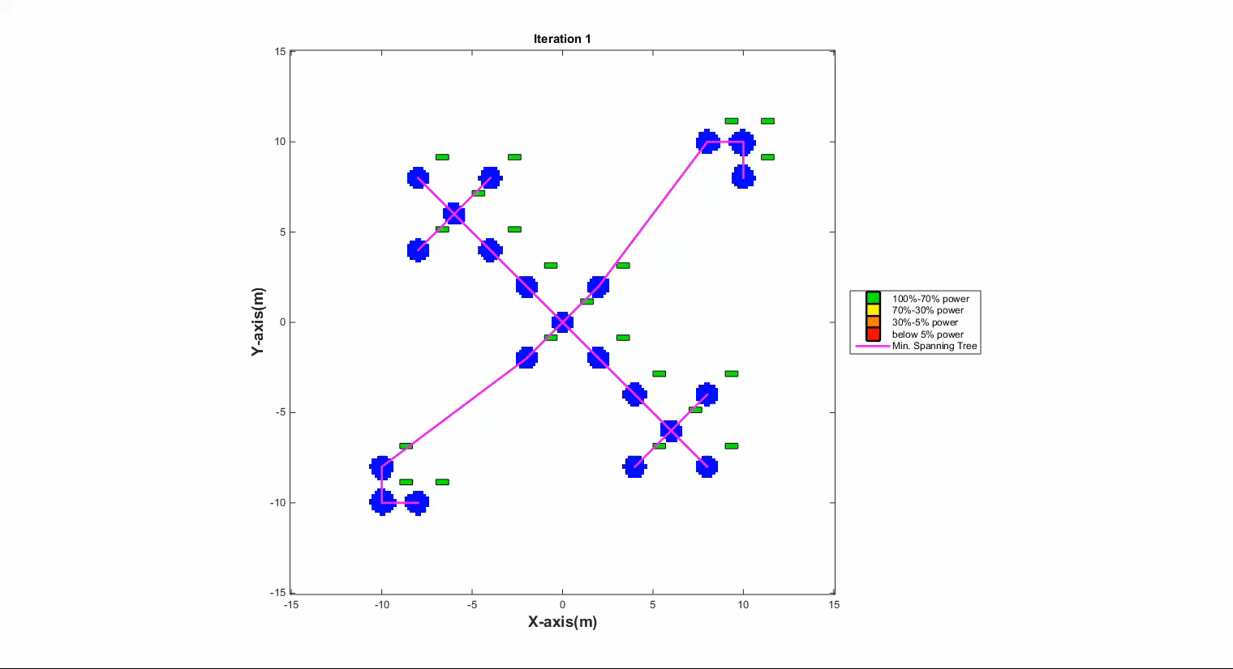
Problem with a Wireless Sensor Network

Slide 3
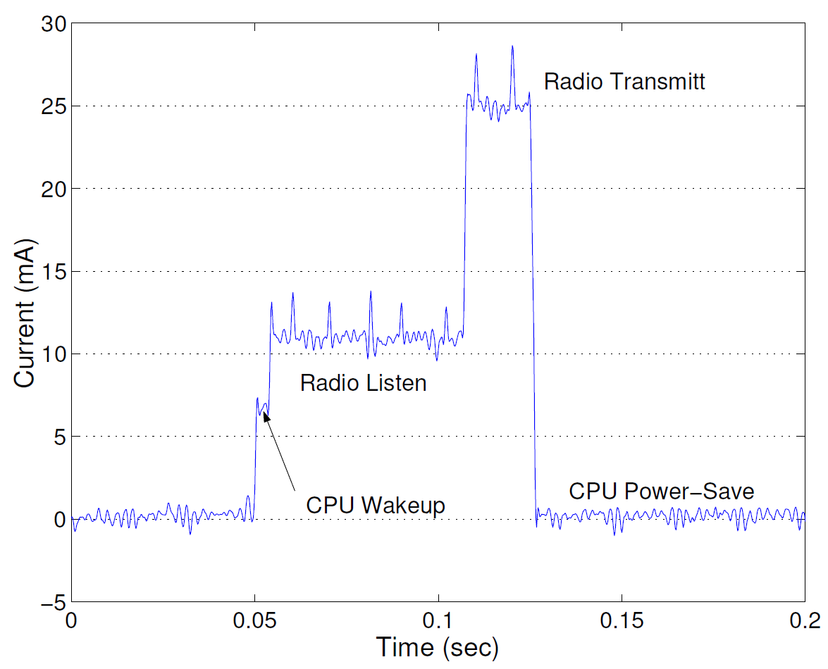
Problem : Wireless Sensor Networks need Energy
Reference: Simulating the power consumption of large-scale sensor network applications, Victor Shnayder et. al., In ACMSensys, Baltimore, MD, November, 2004.
Energy use dominated by transmission and listening costs

Slide 4
Problem : Wireless Sensor Networks need Energy
Some WSN should last for decades, but traditional disposable batteries cannot sustain such a network (Structure-monitoring, Healthcare, Military, Subsea…)
Max energy consumed by wireless transmissions
Reduce Energy: low power Hardware, Low Energy Adaptive Clustering Hierarchy (LEACH),…
Harvest Energy: wind, solar, thermal,…
More Energy: bigger batteries, more batteries, redundant nodes,…

Slide 5





Servicing WSN with UVs
10101…
10101…
10101…
10101…
10101…
10101…
r_{recharge}
r_{data}
Traditional WSN
Dynamic path-planning
We present a path-planning and path optimization algorithms for sustaining WSNs
Robots replenish energy
Robots collect sensed information (cut data transmissions from long to short-distances)

Slide 6
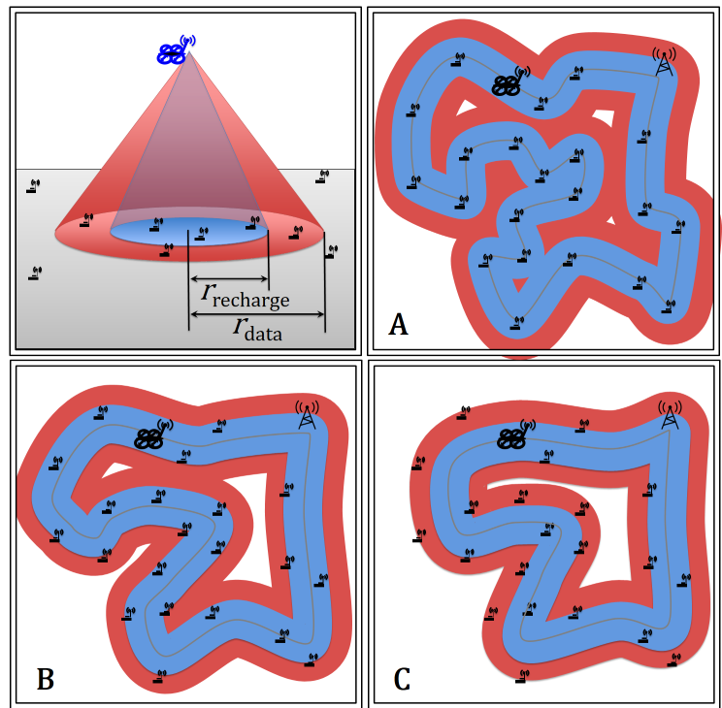

Overview
Optimized path-planning for sustaining a WSN with two algorithms:
Gradient descent on cost function (local minima)
mTSP solver (searches for better rearrangements)
A- Path visits every sensor node
B- Path charges every sensor node, depends on $r_{data}$
C- Path collects data from every sensor node, dependents on $r_{recharge}$

Slide 7
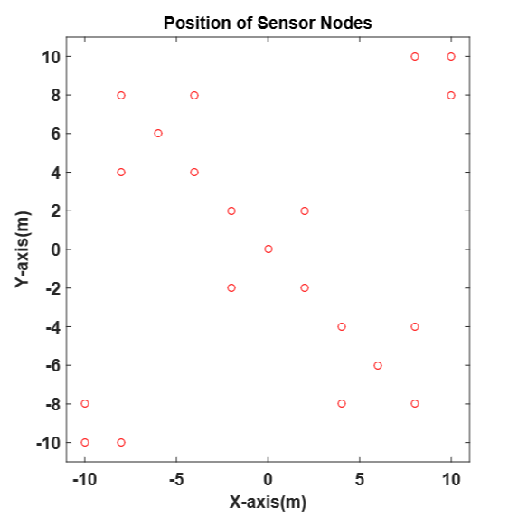
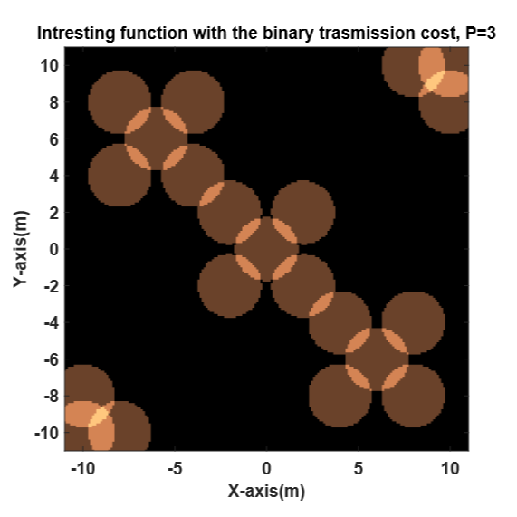

Key Insight: The UV’s Footprint
$$k_{footprint}=\frac{2}{N^{2}−N}\sum_{i}^{N}{{\sum_{j=i+1}^{N}{{{||p}_{i}{−p}_{j}||}_{2}≤}r}_{footprint} }$$
Location of the sensor nodes on a map
Sensor footprint

Slide 8
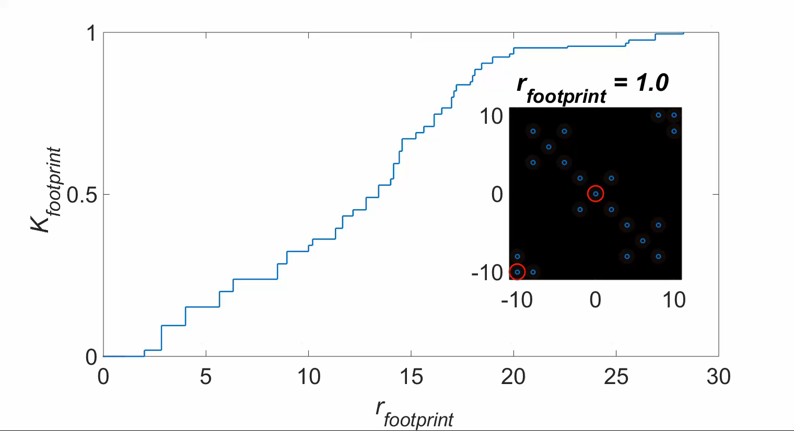
As $r_{footprint}$ grows more sensors recharge simultaneously

Slide 9

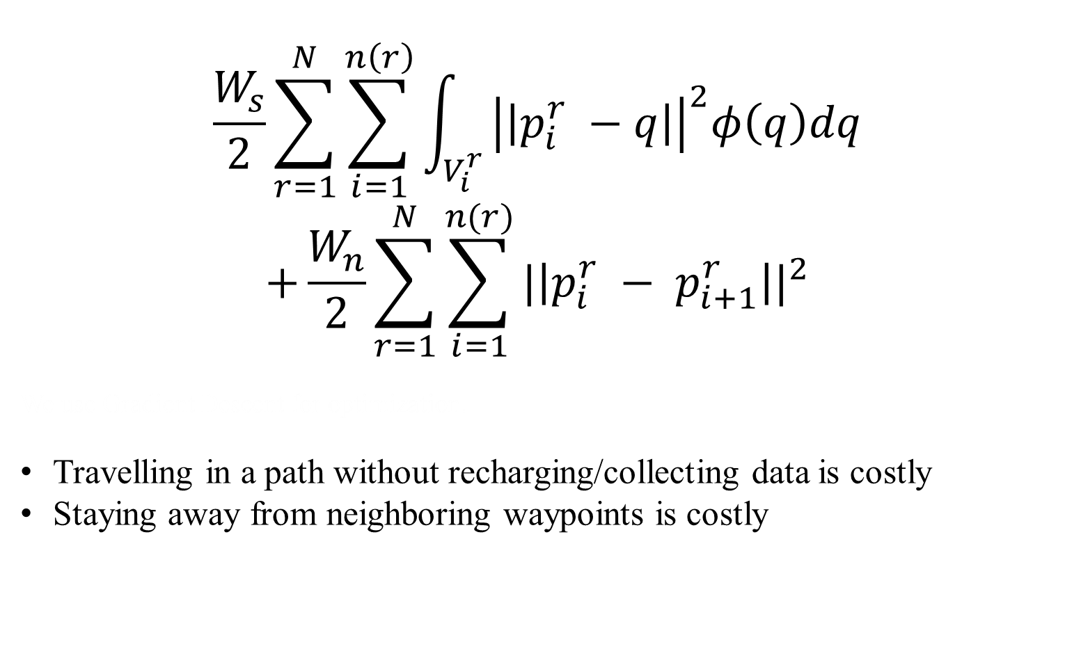
Cost Function to Minimize
$$\frac{W_{s}}{2}\sum_{r=1}^{N}{\sum_{i=1}^{n\left(r\right)}{\int_{V_{i}^{r}}{{\left|\left|p_{i}^{r} −q\right|\right|}^{2}φ\left(q\right)dq}}}$$
$$+\frac{W_{n}}{2}\sum_{r=1}^{N}{\sum_{i=1}^{n(r)}{{|\left|p_{i}^{r} − p_{i+1}^{r}\right||}^{2}}}$$
We use Gradient Descent for optimization.
Travelling in a path without recharging/collecting data is costly
Staying away from neighboring waypoints is costly
H =
$q$ - points on the map
$p_{i}^{r}$ - waypoint i of $robot$ r
$φ\left(q\right)$ - Interesting function
$W_{n}^{}$ and $W_{s}^{}$ are scalar weights

Slide 10
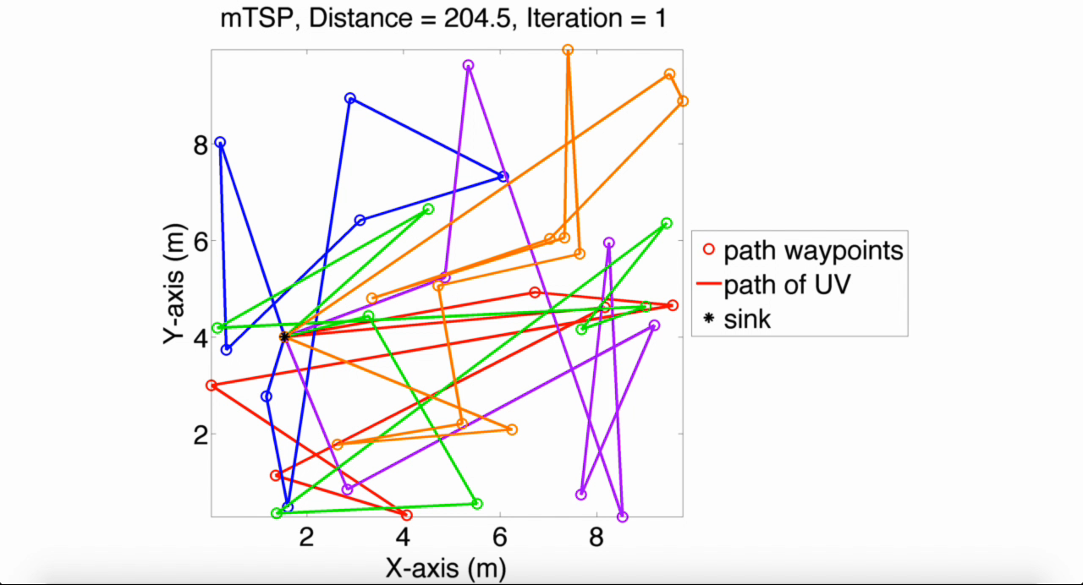
mTSP - (multiple Travelling Salesman Problem)

Slide 11
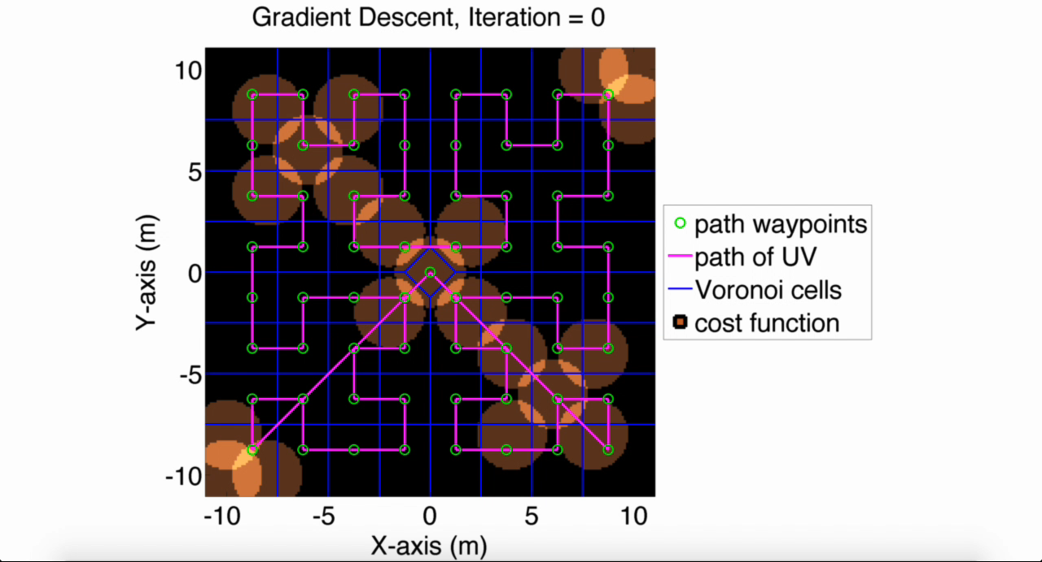

Slide 12
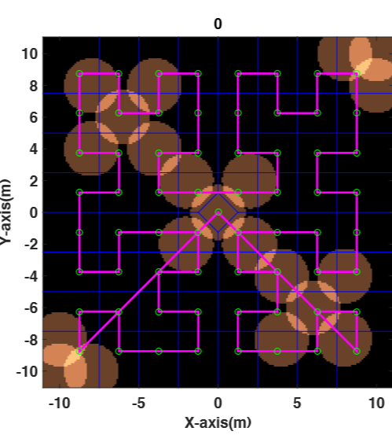
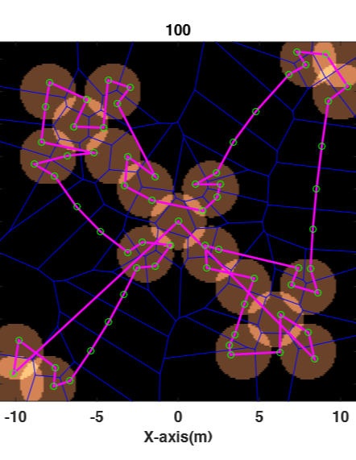
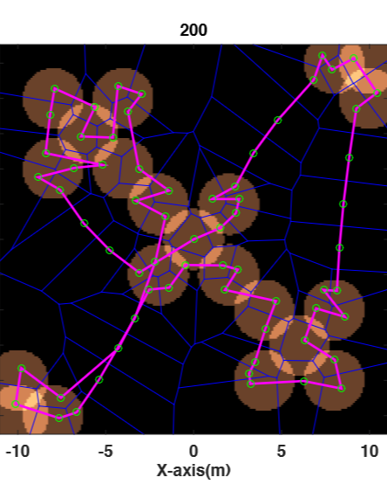
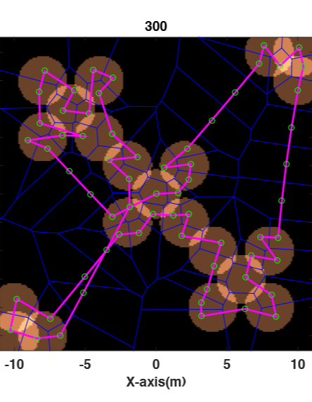
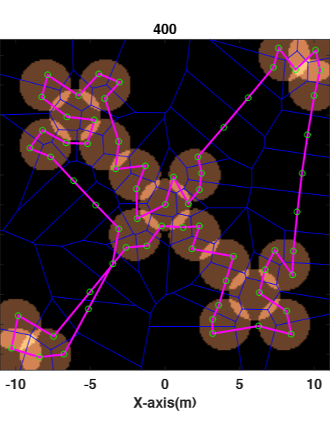
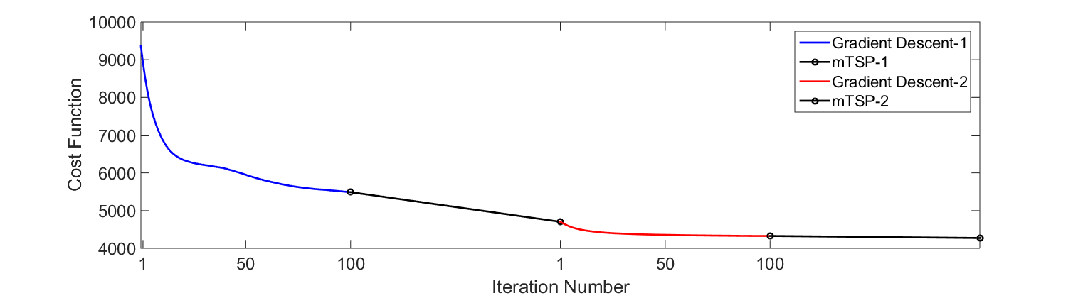
Results with One Robot

Slide 13
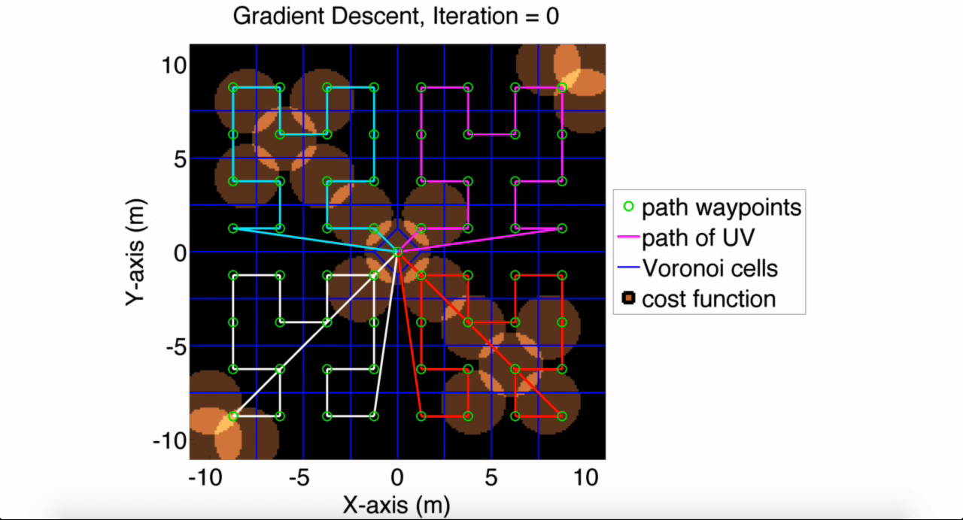

Slide 14
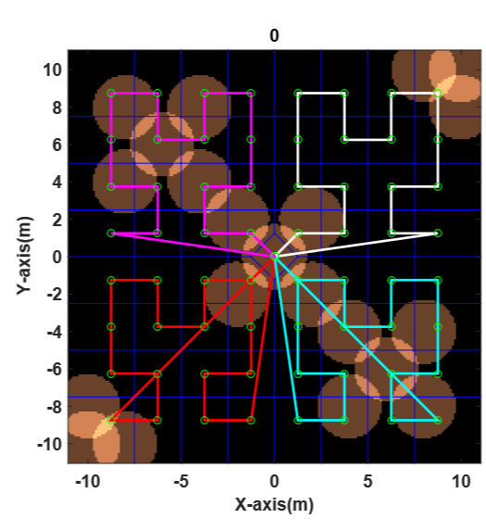
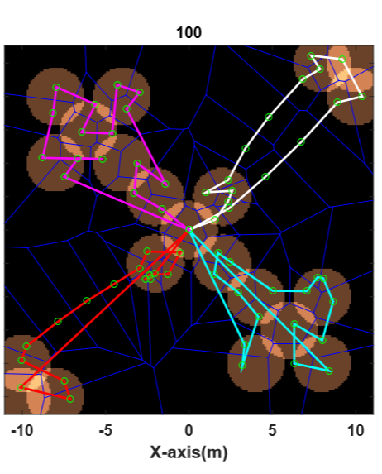
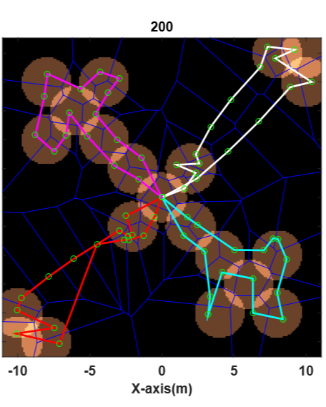
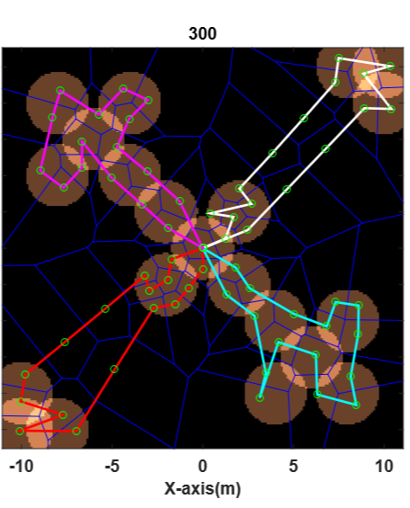
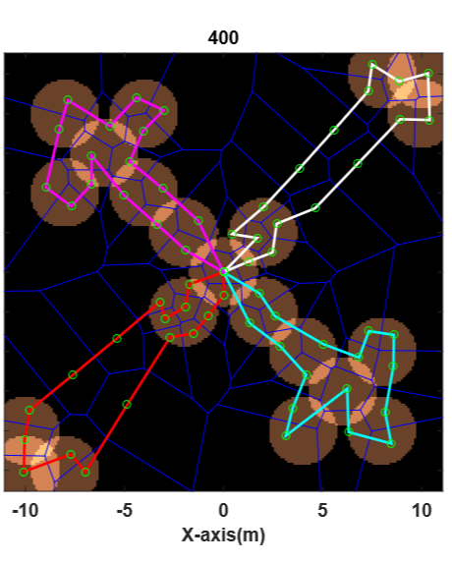
Multi-Robot Results

Slide 15
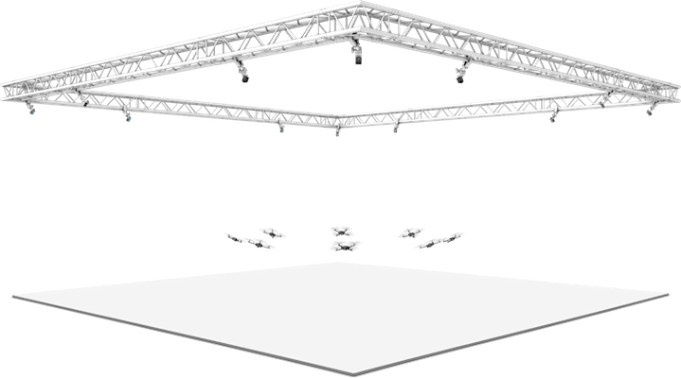
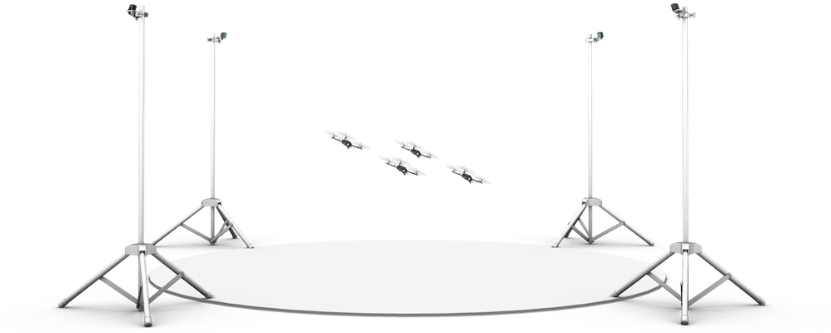
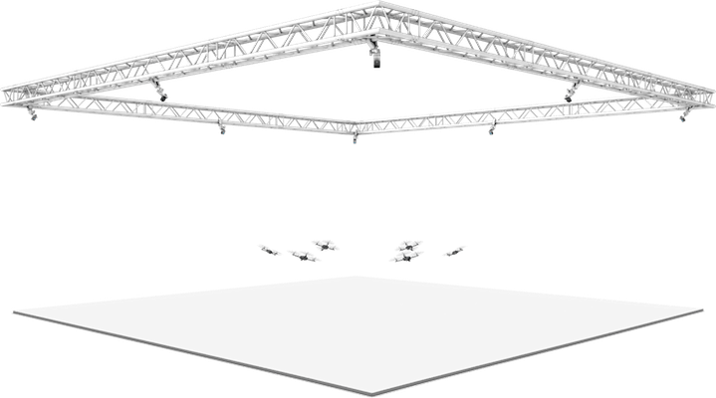




Future Work
Extend simulation to handle non-stationary sensor nodes. UVs modify routes to maintain service
Improve convergence rate by adapting other optimization techniques
Test the algorithm on mobile-robots, eventual implementation on quadcopter swarm
Region
of interest
Region
of interest
Region
of interest

Slide 16

Conclusion
Optimized path-planning for sustaining a WSN with two algorithms:
Gradient descent on cost function (local minima)
mTSP solver (searches for better rearrangements)
A- Taking a path to visit every sensor node
B- Taking a path to charge every sensor node, this is dependent on $r_{data}$
C- Taking a path to collect data from every sensor node, this is dependent on $r_{recharge}$
I SINCERELY THANK
Baylor University-Waco
University of Houston
Prof. Aaron T. Becker

